Slide 1
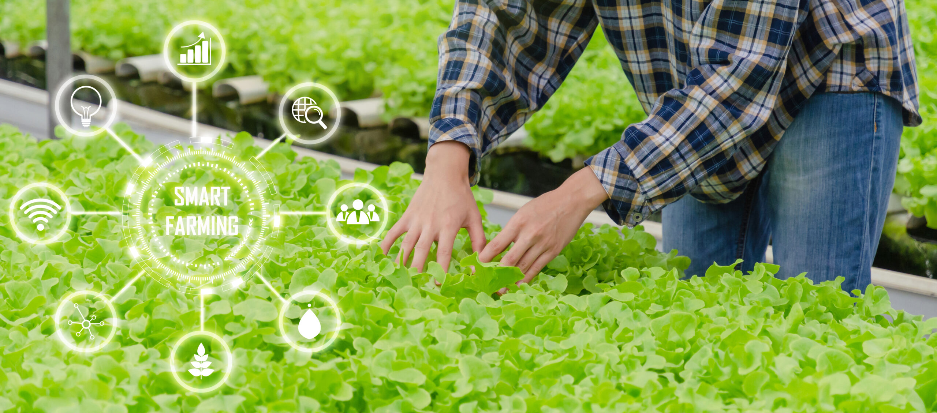

Slide 2
content
Overview
Problems we aim to solve
Project Modules
Brief Description
Technical Details
Additional Features

Slide 3
Overview
Our project is a smart farm system that reads several agricultural sensors including a camera and feeds the data to a backend server.
The server then saves the received data in a database and renders it to a website on which the farm owner can monitor his farm health and make sure that everything is going well.

Slide 4
Problems we aim to solve
No convenient way to easily monitor the current state of the farm to check on its health.
Huge amount of effort done and time taken to keep track of time and regularly water the crops.
Lack of sunlight.
Waste of water in irrigation process.
Detecting pests and notifying the owner.

Slide 5
Project Modules
Hardware Module
The Farm Itself
Sensors
Camera Module
Wi-Fi Module
Watering System
LED Grow Lights

Slide 6
Project Modules
Software Module
Server Set-up
ARM Firmware

Slide 7
Diagram

Slide 8
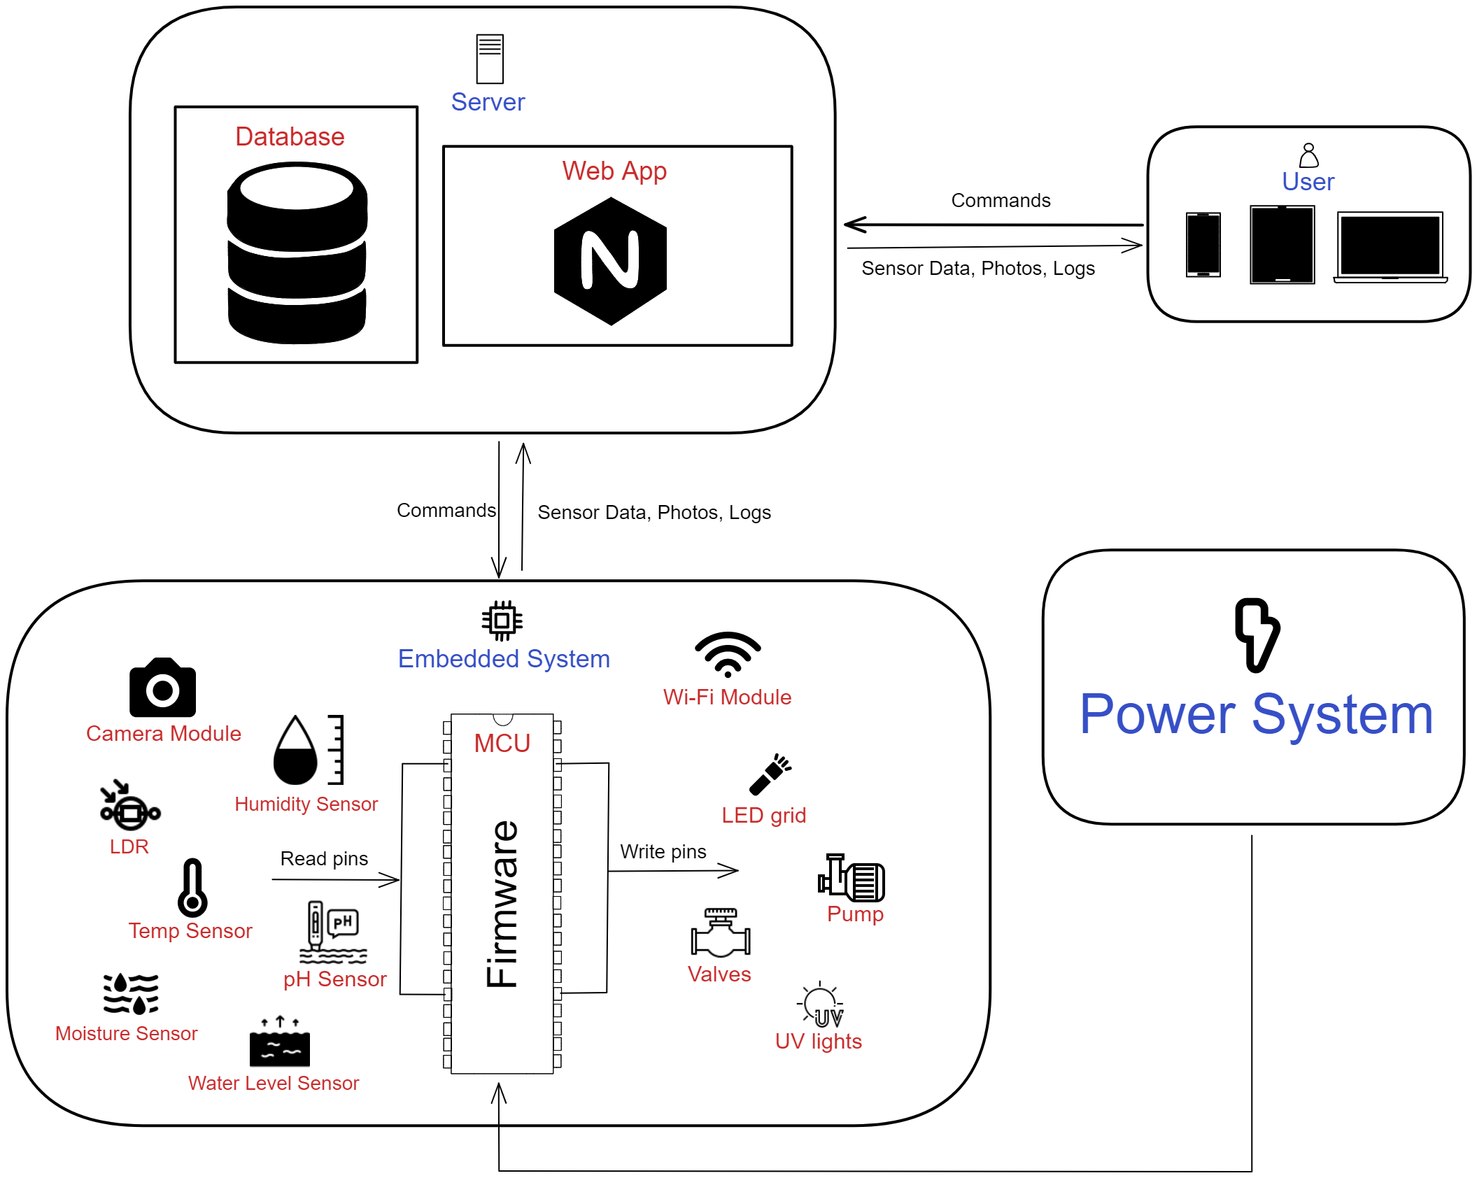

Slide 9
Brief Description
The main goal of the project is for the farm owner to be able to monitor his farm health and vital parameters. As well as to automate the irrigation process for him.
All he has to do is log what seed he planted and where on the website portal then the system will adjust accordingly.

Slide 10
Technical Details
MCU
The main component that controls the overall system and has the core logic on which the system runs is the microcontroller.
We will be using ARM based microcontroller as it provides many features that will make it much easier for us to implement the required system without needing additional external IC’s.

Slide 11
Technical Details
Sensors
Camera module
Water level sensor
LDR
Humidity sensor
Moisture sensor
PH sensor
Temperature sensor

Slide 12
Technical Details
Actuators
LED grid
Valves
Pump
UV lights

Slide 13
Technical Details
Camera
The MCU takes a photo through the camera module every 5 minutes to update the camera feed on the website.
The camera module we will be using is “OV7670”.
The MCU configures the camera module registers through SCCB interface which is very similar to I2C.
This module provides programmable brightness, gain, hue, saturation and other image processing parameters that we will use.

Slide 14
Technical Details
Camera (Cont.)
This module provides programmable brightness, gain, hue, saturation and other image processing parameters that we will use.
Another reason for using ARM based MCU like stm32 is that it has a DCMI peripheral that receives the pixels array data from the camera module.

Slide 15
Technical Details
Wi-Fi Module
We use this module to send sensor data, photos and logs to the server backend.
The Wi-Fi module we will be using is “ESP-01S”.
This a Wi-Fi Serial TTL Module that enables us to communicate with ESP8266 through serial protocol.

Slide 16
Technical Details
Server
The user logs into a website to monitor his farm.
The user will send to the server information about what seeds he has planted and where, so that the server saves it into the database and sends this information to the MCU.
Then, the MCU will adjust its timer and system behavior to be able to water the plants at the right time.

Slide 17
Technical Details
Server (Cont.)
The server is responsible for receiving sensor data from the MCU and saving it into the database for future reference. It also renders the HTML files to the user.
The MCU communicates with the server through the Wi-Fi module sending sensors’ data and logs.
The user will be mostly monitoring and not really sending any data or commands to the server.

Slide 18
Technical Details
Watering System
There are two tanks in the system:
Main tank: supplies water for the plants.
Secondary tank: has the remaining water used in the irrigation process which passes through the filtration system for reuse.

Slide 19
Technical Details
Watering System (Cont.)
Water level sensor is used to detect if the main tank is running low. If it is, the MCU will send a control signal to the pump to refill the empty tank with filtered water found in the secondary tank.
The MCU sends a control signal to open or close a particular valve according to the data the user has sent previously.

Slide 20
Technical Details
LED Grow Lights
LDR is used to detect if there is enough light coming through to the plants. If there isn’t any light, the MCU will send a control signal to the LED grow lights giving the plants the light they need for photosynthesis process.

Slide 21
Technical Details
Power Supply System
Our system has many hardware components that require stable power input.
Our system has two main power sources:
Rechargeable battery: provides power for the system in case of a black out.
Wall plug-in: A circuit that essentially uses a step-down transformer and a voltage regulator.

Slide 22
Additional Features
Plants disease/pest detection model.
Filtration system
Additional Features
Rain drops collector
Power saving mode

Slide 23
Thanks.

